Slide 1
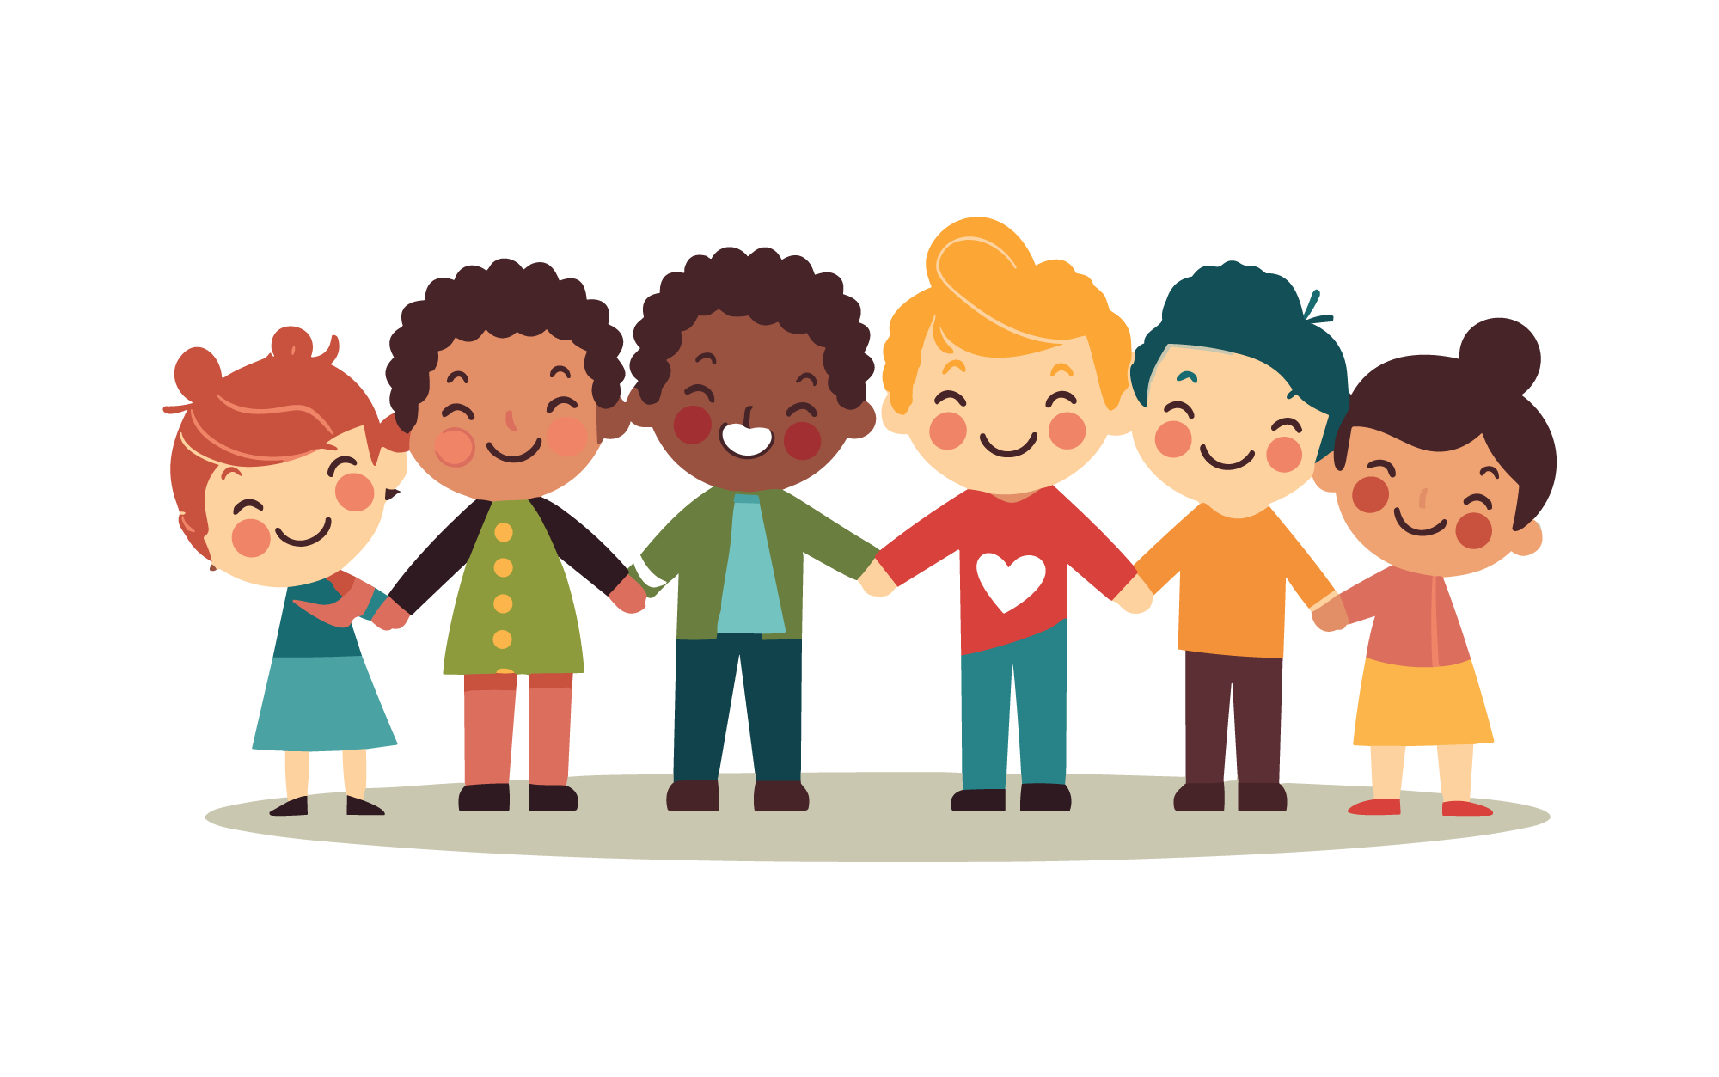
Be Kind
lausd.org/human-relations

Slide 2
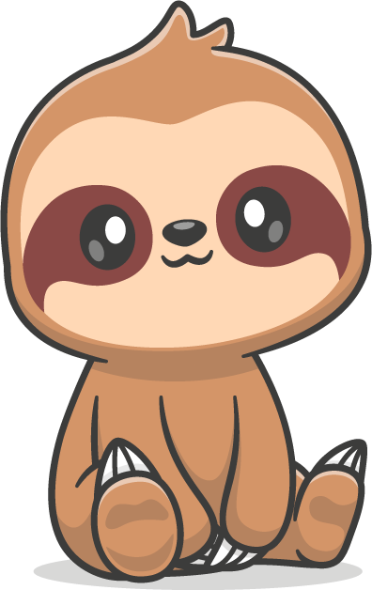
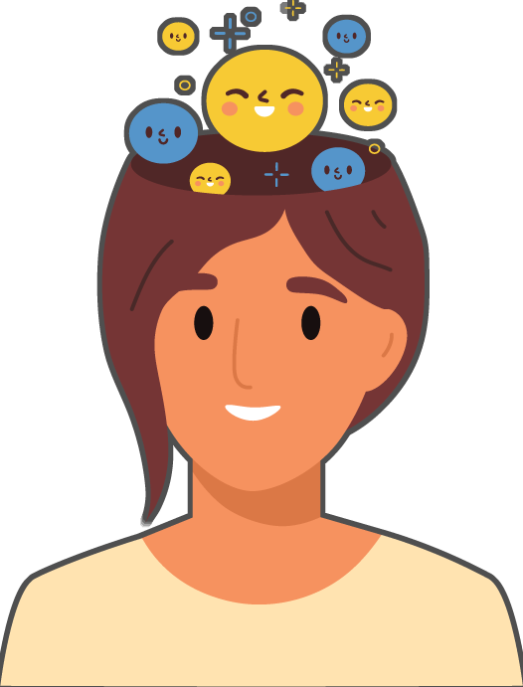
Would You Rather
Talk to animals
Read peoples minds
lausd.org/human-relations

Slide 3
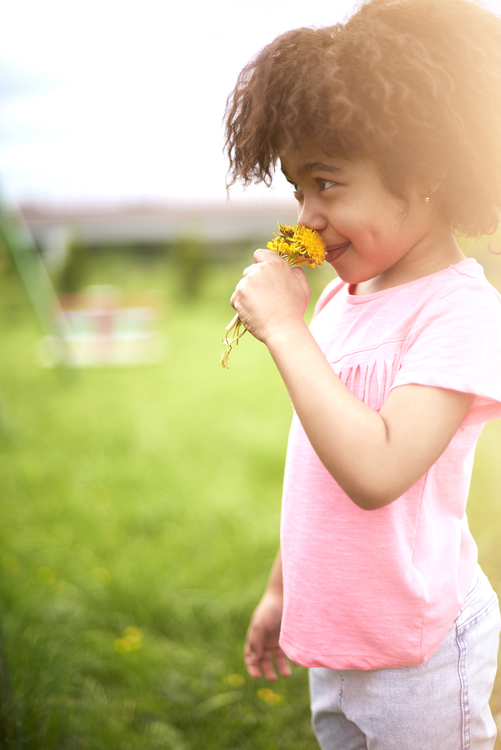
Pair Share
Do you know what kindness is?
lausd.org/human-relations

Slide 4
What is Kindness?
lausd.org/human-relations
Notes:
https://www.youtube.com/watch?v=BNNcpAcF0GM

Slide 5
Make a Choice to Be Kind!
Every day we can make a choice to be kind!
Kindness is doing nice things to show you care.
There are lots of ways to be kind like taking turns, sharing, helping to clean, or even giving hugs (with permission)!
lausd.org/human-relations

Slide 6
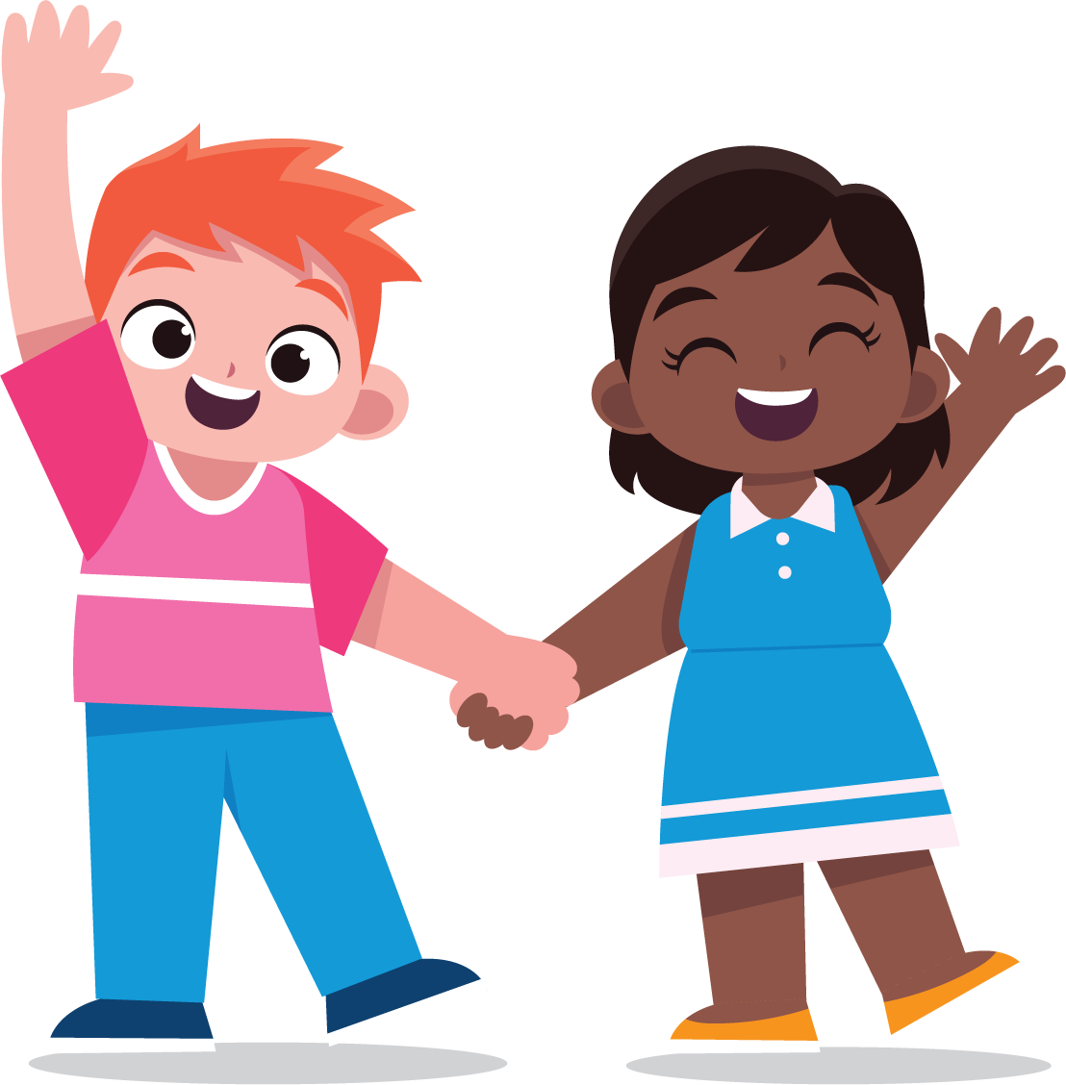
Why Kindness?
Did you know that BEING kind to someone else can make YOU feel happier?
In fact, BEING kind helps us to feel more gratitude, and more connected to the people around us!
Also, BEING kind helps reduce our stress!
lausd.org/human-relations
lausd.org/human-relations

Slide 7
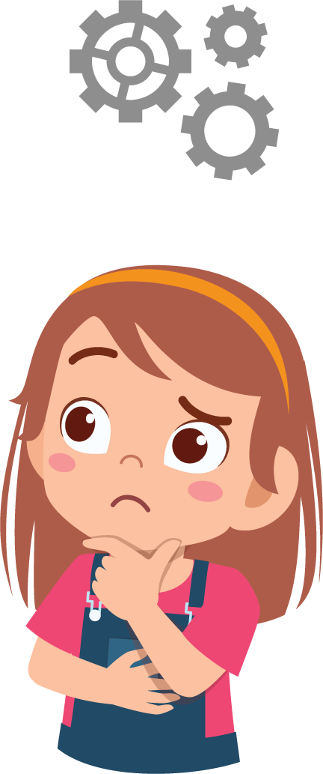
Pair Share
If BEING kind can do all of THAT for someone, what do you think it does for the person receiving the kindness
lausd.org/human-relations

Slide 8
What is Kindness?
lausd.org/human-relations
Notes:
https://www.youtube.com/watch?v=mdA2sByFX1I

Slide 9
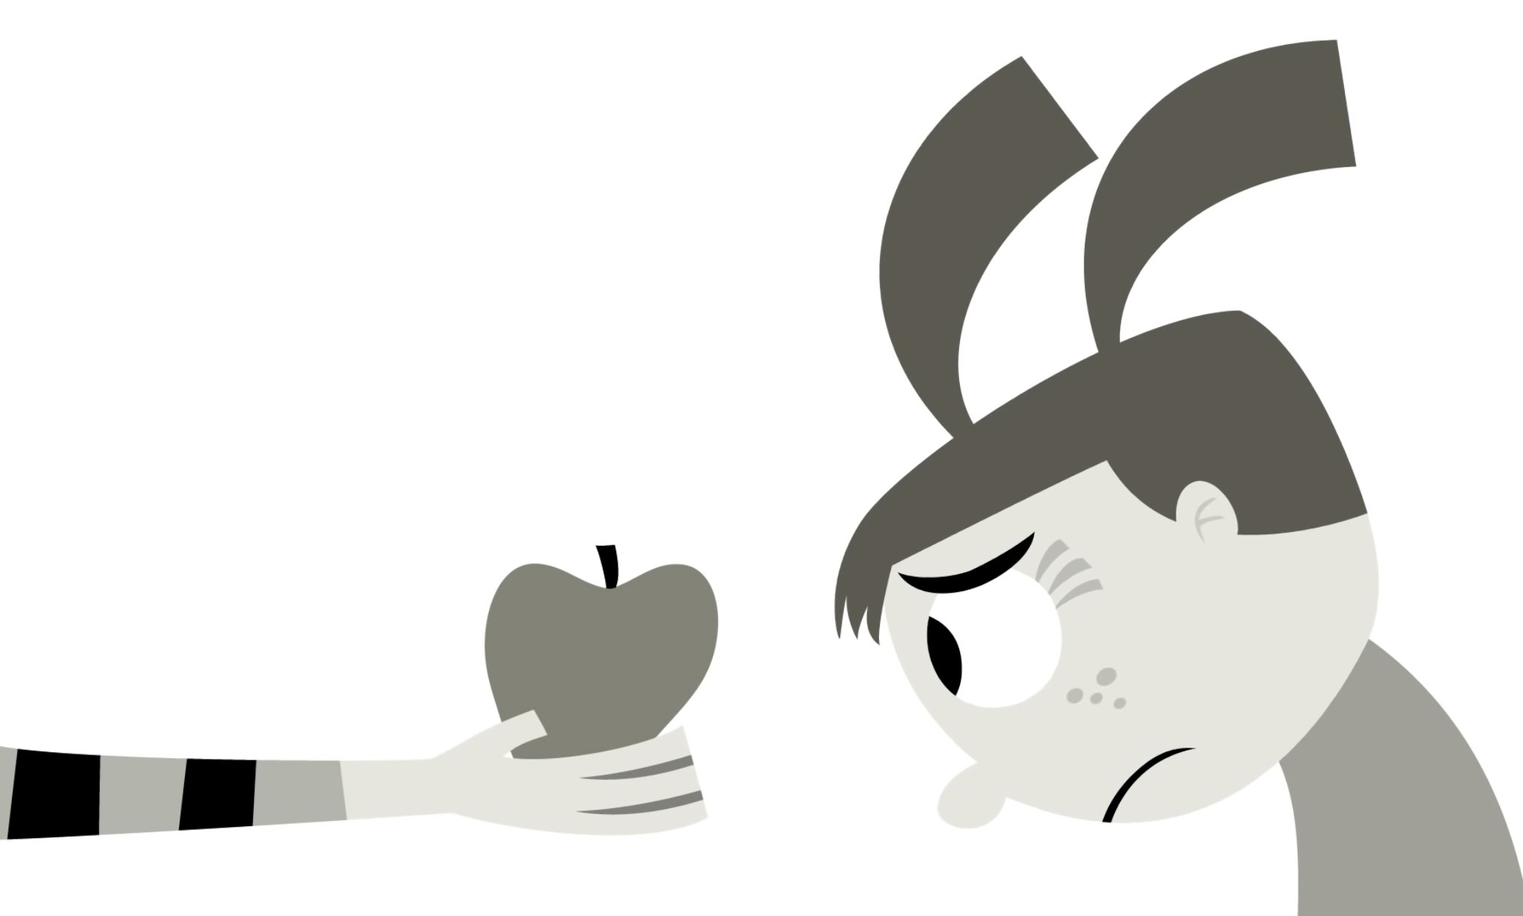
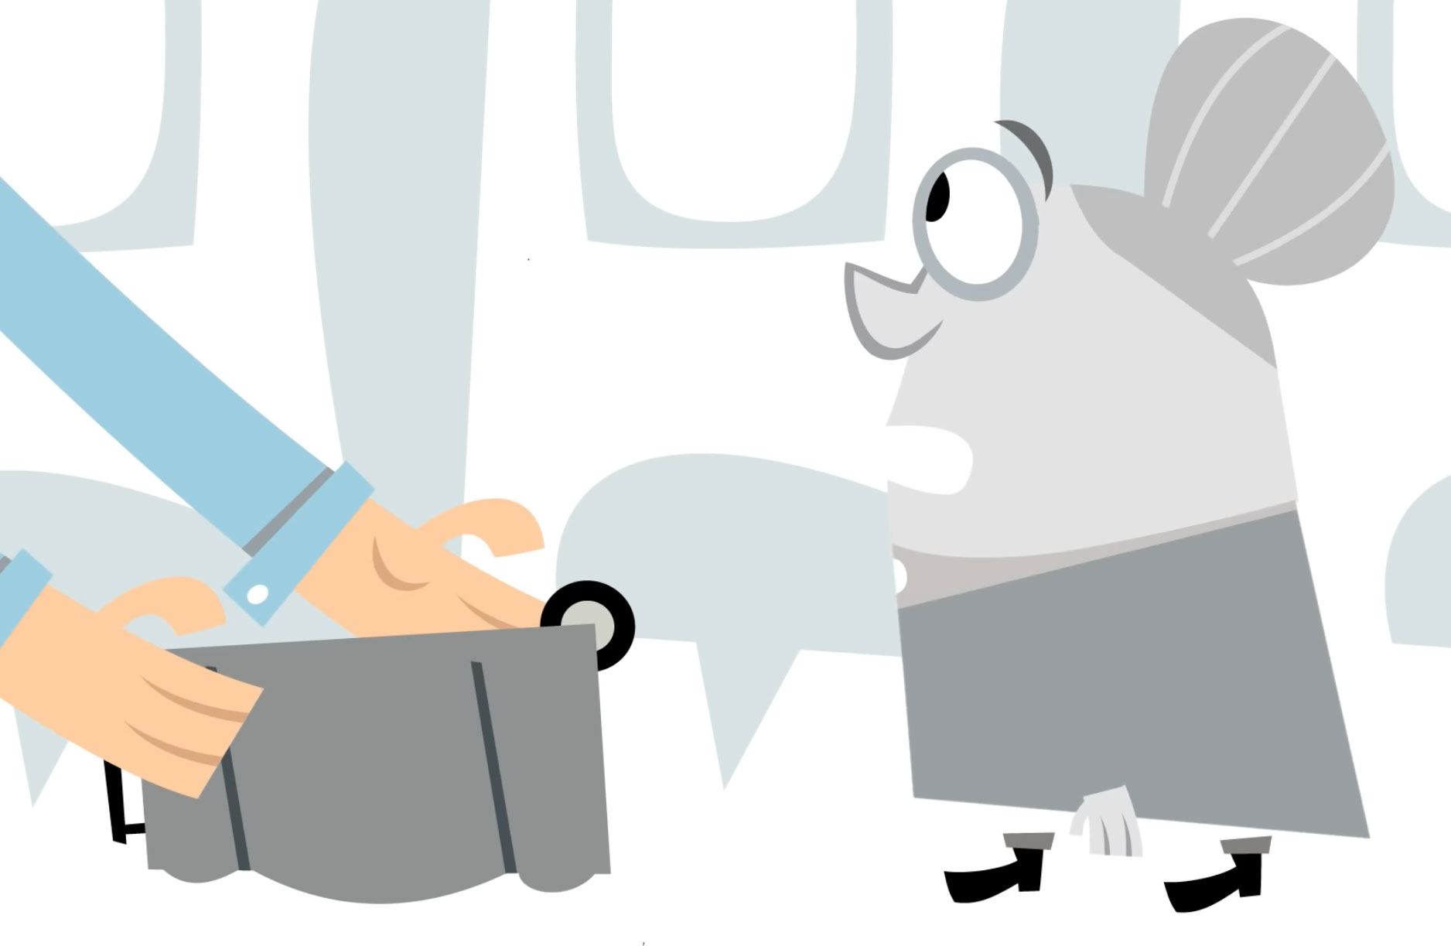
Acts of Kindness
We saw a lot of folks choose kindness in that video!
Let's name a few of the acts of kindness we saw.
lausd.org/human-relations

Slide 10
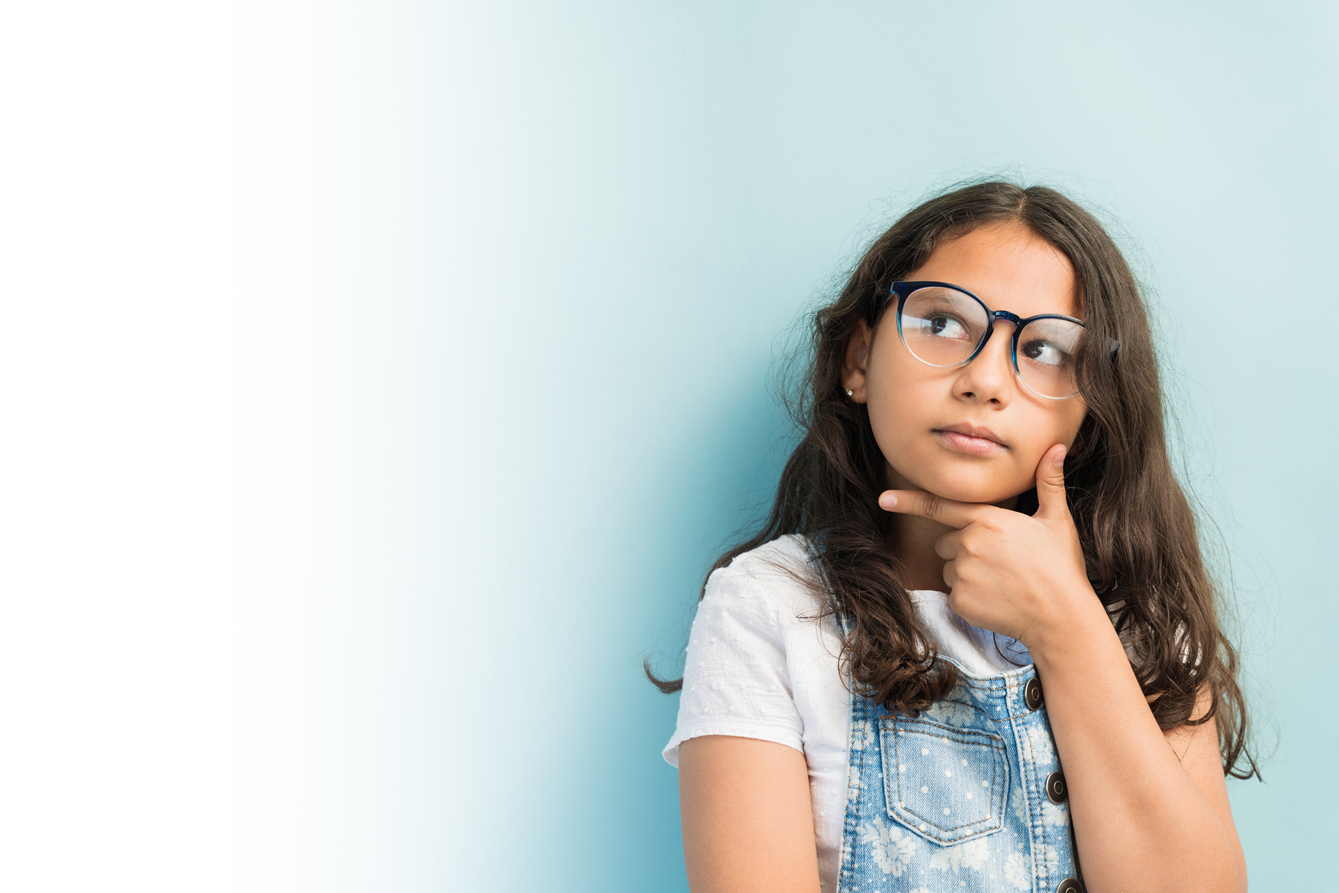
Choose Kindness
What are some acts of kindness you can choose today?
lausd.org/human-relations

Slide 11
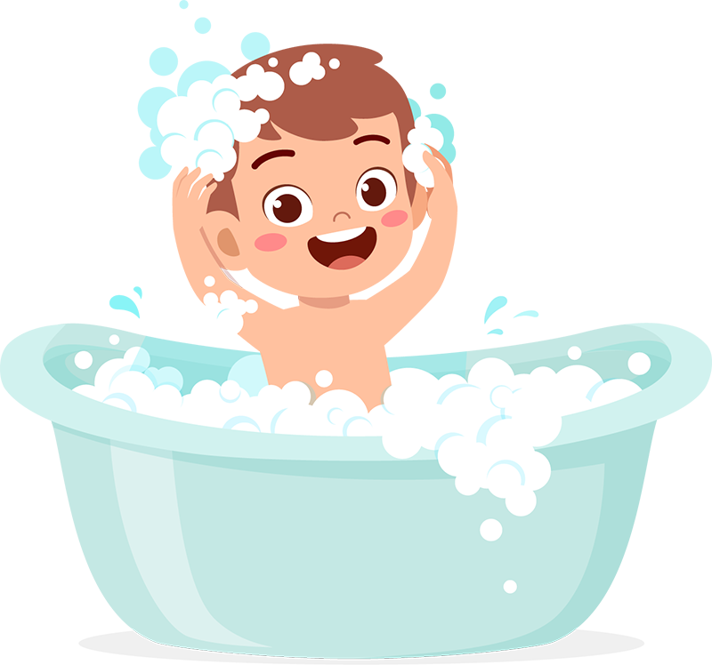
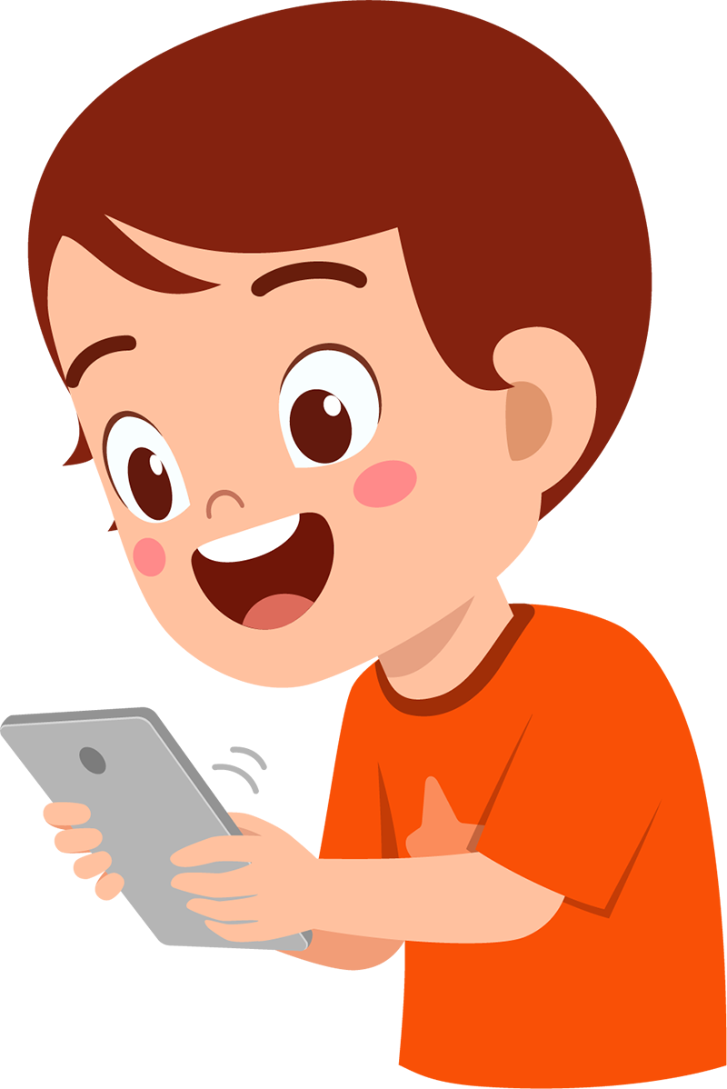
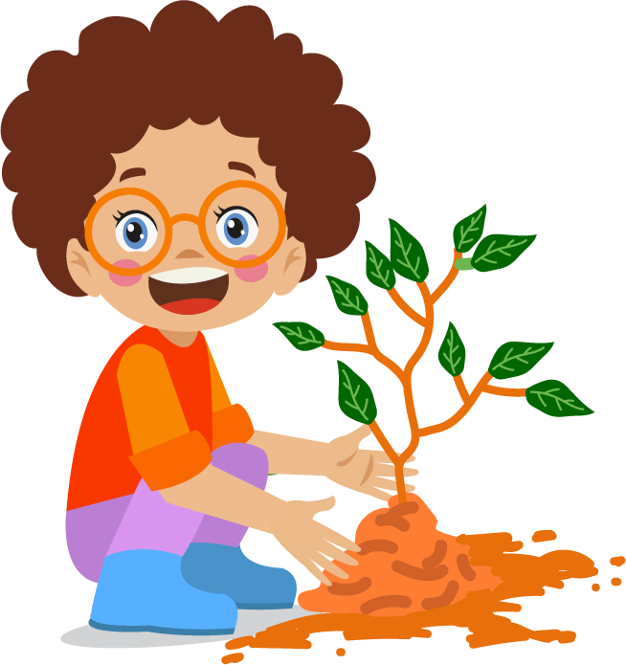
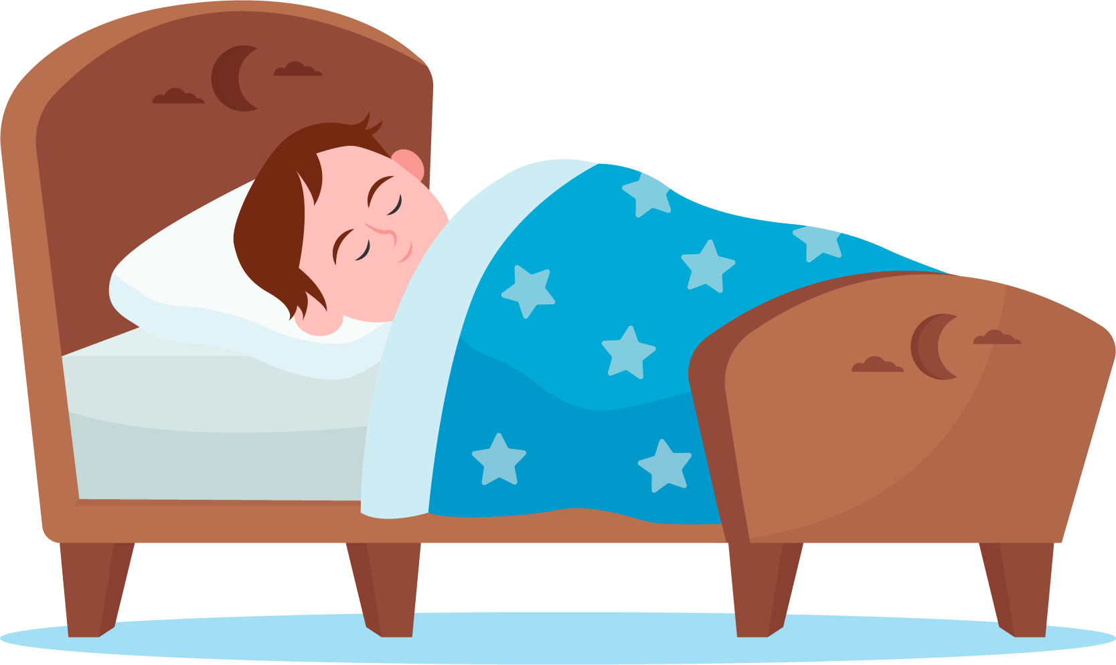
Check Out
What will you do for yourself today?
Take a bath
Listen to music
Read a book
Call a friend
Enjoy nature
Take a nap
lausd.org/human-relations

Slide 12
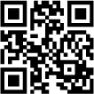
Committed to fostering a safe and respectful District, school and community culture where the seeds of peace and justice are down so that all students and staff can lead safe, purposeful and academically fruitful lives.
Connect with us at bit.ly/LAUSD-HRDE
lausd.org/human-relations

